Slide 1
Reading activity
Can you read this?
I cnduo't bvleiee taht I culod aulaclty uesdtannrd waht I was rdnaieg. Unisg the icndeblire pweor of the hmuan mnid, aocdcrnig to rseecrah at Cmabrigde Uinervtisy, it dseno't mttaer in waht oderr the lterets in a wrod are, the olny irpoamtnt tihng is taht the frsit and lsat ltteer be in the rhgit pclae. The rset can be a taotl mses and you can sitll raed it whoutit a pboerlm. Tihs is bucseae the huamn mnid deos not raed ervey ltteer by istlef, but the wrod as a wlohe. Aaznmig, huh?

Slide 2
Literacy Workshop
Parent Reading and Spelling Workshop
Whole School

Slide 3
Welcome
EYFS/KS1 Literacy Co-ordinator – Miss M. Frith
KS2 Literacy Co-ordinator – Miss H. Glover

Slide 4
Areas of Literacy
Reading
Writing
Speaking and Listening
SPAG

Slide 5
Reading
‘Children are made readers on the laps of their parents’
Emilie Buchwald
Teaching reading: phonics
Shared reading
Guided reading
Genres: Fiction, non-fiction, poetry, plays
Silent Reading
Reading Buddies
Individual reading books
Library books
1:1 Reading
Reading throughout the curriculum

Slide 6
Reading
Supporting your child at home …
Focus on letter sounds and names (EYFS and KS1)
Choose books that are interesting to your child
Provide a comfortable area for reading enjoyment
Set a routine time for reading that’s not assigned, eg. at bed time or after dinner.
Reading Games
Reading at least 10 minutes 5 times a week.

Slide 7
Reading Homework
Supporting your child at home …
Reading books should be read at least 10 minutes every day. This is now a priority and has been made one of the children`s main homework tasks.
Reading records - to be signed and dated by parent/ adult, detail on how your child has read, strength and difficulties.
Ask your child questions about what they have read.

Slide 8
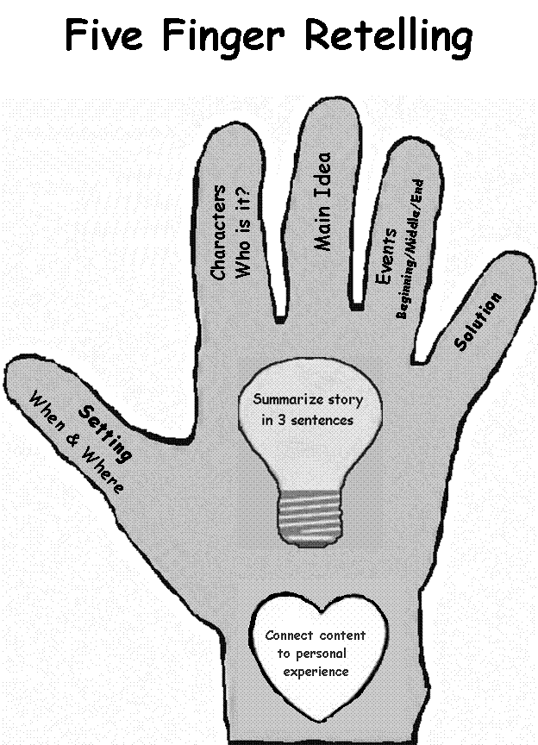

Slide 9
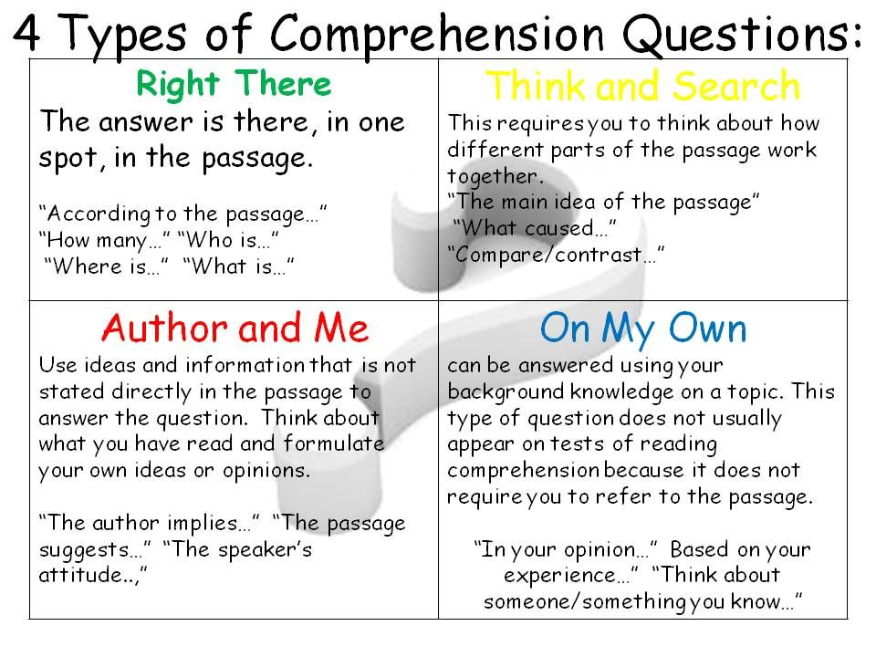

Slide 10
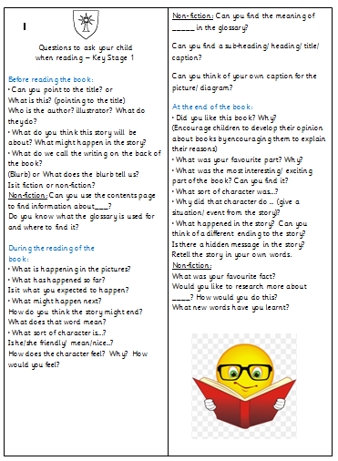
Reading bookmarks
We have put together reading bookmarks to keep with reading record books.
Minimum of one question a week to be answered in your child`s reading record book to develop understanding of the text.

Slide 11
Parent Booklets
Reading and Writing - Expected by the end of the year booklets to be sent home by class teacher.
Common exception words to be learnt throughout the year. List will be sent home by class teacher.
Phonic sound card for EYFS and KS1

Slide 12
Why is correct spelling so important?

Slide 13
I take it you already know Of tough and bough and cough and dough? Others may stumble but not you On hiccough, thorough, slough and through. Well done! And now you wish perhaps, To learn of less familiar traps? Beware of heard, a dreadful word That looks like beard and sounds like bird. And dead, it's said like bed, not bead for goodness' sake don't call it 'deed'! Watch out for meat and great and threat (they rhyme with suite and straight and debt).

Slide 14
Spelling at School
Phonics (Reception – Year 2) Letter and sound correspondences Segmenting words (splitting them into the smallest sounds – phonemes) to spell Irregular/ high frequency words, e.g. the, people

Slide 15
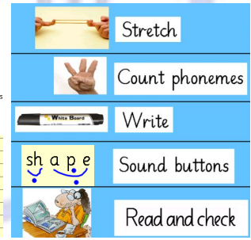
Spelling at School
Phonics (Reception – Year 2) Letter and sound correspondences Segmenting words (splitting them into the smallest sounds – phonemes) to spell Irregular/ high frequency words, e.g. the, people

Slide 16
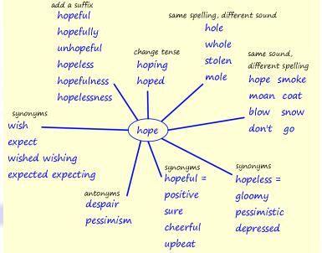
Spelling at School
Spelling (Year 3 - 6)
investigate, practise, apply Prefixes and suffixes (e.g. adding –un, -re, –ly, -ful, -ed)
Letter strings, e.g. /shun/ - station, passion, magician Specific dyslexia-friendly spelling strategies
Read Write Inc Spelling
Programme

Slide 17
Spelling at Home
Create a quiet, relaxing environment for spelling practice.
Build spelling practice into your daily routine – how can you integrate 10 minutes practice a day?
Provide encouragement and use your parental judgement. Does your child need more or less adult support?
Can they spell the words and need to be extended? Do they need fewer or easier words?
Children might need support with choosing the most appropriate strategies (the strategies that reflect how they learn best and the strategies that are most appropriate for that word).

Slide 18
Spelling
Common Exception Words
Spelling Shed

Slide 19
Any Questions?

